Slide 1


Slide 2
AI Governance
Óscar Lara-Yejas, Ph.D.
Principal AI Engineer, IBM Client Engineering

Slide 3



Let me tell you the story of María…

Slide 4
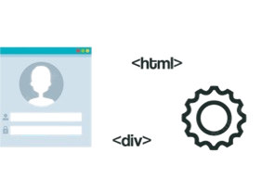


María is a brilliant AI Engineer
and builds generative and predictive AI applications

Slide 5

Her team has built
prototypes for:
Summarization
RAG
Code generation
Predictive analytics

Slide 6

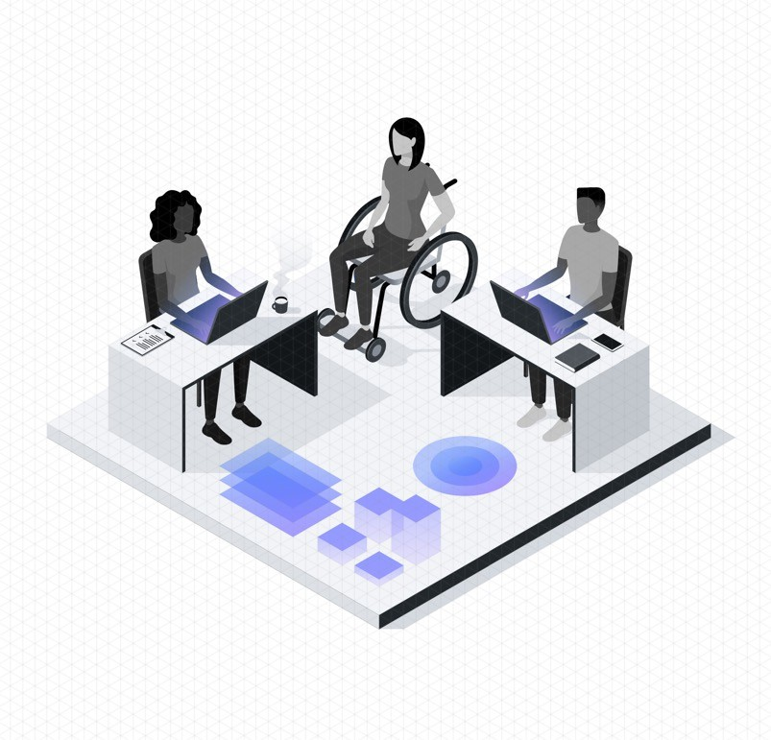
Management wants to go to market
ASAP
Results are promising!!!

Slide 7

many challenges to go to production
Risks!!!

Slide 8

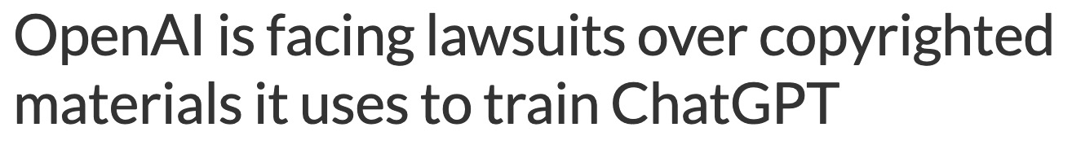

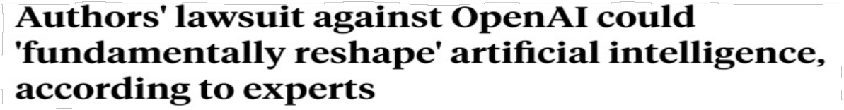
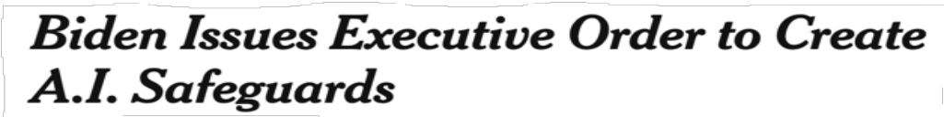
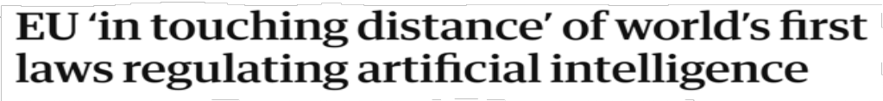
The AI landscape: lawsuits and regulations

Slide 9

AI Governance
AI Governance
AI Governance

Slide 10

Explainability
Hallucinations?
Where to begin??
Laws and regulations

Slide 11
Governing not only models but
prompts running on top of
LLMs?

Slide 12

What does María need?
3 pillars of
AI Governance

Slide 13
Pillar 1
Transparency across her models and prompts
for each AI asset: what parameters? what data?
what few-shot examples? what LLM were used?

Slide 14
Pillar 1
different platforms
centralized inventory of these AI assets

Slide 15
Pillar 1
Models / prompts have different versions and may be running on development, pre-production or production environments

Slide 16
Pillar 1
We call this first pillar:
Lifecycle Governance

Slide 17
Pillar 2
Monitoring
drift or decay in the performance over time due to changes in the data or processes
retrain / re-engineer to maintain performance

Slide 18
Pillar 2
fairness issues?
Is the model is producing consistently unfavorable outcomes against a certain population?
answers of the model… need to be explained or cited to guarantee faithfulness
Second pillar: Risk management

Slide 19
Pillar 3
comply with regulations
EU AI Act
NY Local Law 144
complex to understand
Third pillar: Regulatory compliance

Slide 20
How can we help María address all these issues?

Slide 21
watsonx.governance
Introducing…
The Essentials Cloud Plan - One unified, integrated AI Governance platform to govern Generative AI and Predictive ML
Monitoring and alerts
Get alerts when LLM thresholds are breached
AI Transparency
Capture model metadata automatically while tracking AI Lifecycle, model health, and drift
Monitor both LLMs and Predictive ML
Use a single plan with simple consumption-based pricing
GAed: Dec 1, 2023

Slide 22
FIVE important points

Slide 23
1. Does the story of María ring a bell?
This is exactly what our clients are going through as they plan to go to production

Slide 24
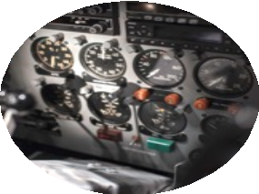
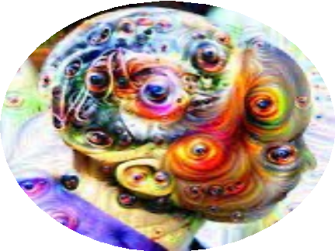

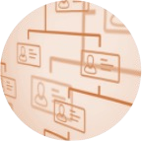


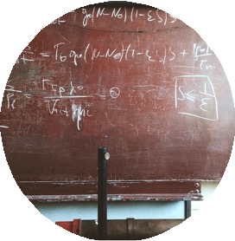


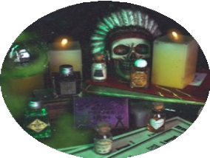

2. AI Governance is not only for Gen AI
Some AI risks are the same as in traditional data science
But many risks are entirely new in foundation models
hallucinations
lack of factuality or faithfulness
lack of source attribution
toxicity, profanities, and hate speech
bullying and gaslighting
poor predictive accuracy
lack of fairness and equity
lack of explainability
model uncertainty
distribution shifts
poisoning attacks
evasion attacks
extraction attacks
inference attacks
model transparency
inability to reason
privacy leakage
prompt injection attacks
misinformation
Occur when LLMs are used in “classical ML” tasks, e.g., prediction and classification, and have well-defined metrics and defenses, i.e. IBM Trust 360 toolkits.
Occur when LLMs are used in generative tasks, and do not yet have well-defined metrics and defenses.

Slide 25
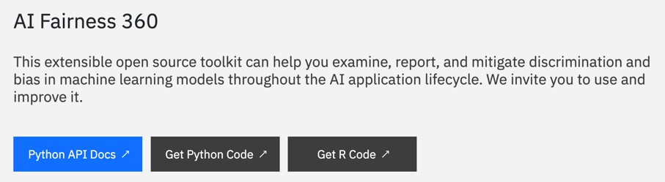
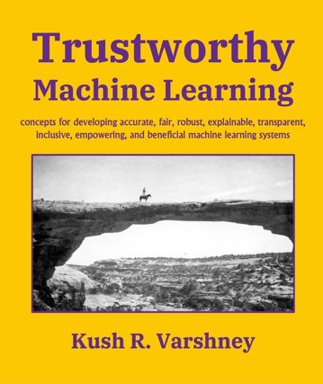



3. IBM’s been leading AI Governance for a decade
https://aif360.res.ibm.com/
Book: Trustworthy AI
https://ai-explainability-360.org/
Products:
AI FactSheets

Slide 26
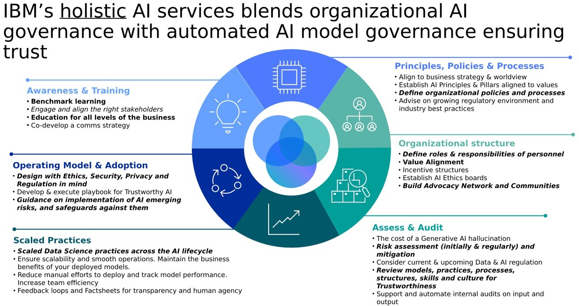
4. AI Governance is more than technology
Organizational AI Governance IBM Consulting’s expertise: here

Slide 27
5. This is how we win
.

Slide 28
In the next day and a half:
Demo, features, roadmap
Where can I find assets?
Metrics and evaluation of LLMs
Hands-on lab on assisted prompt evaluation
Hands-on lab on monitoring and lifecycle governance
OpenPages for regulatory compliance
Engaging clients Much more

Slide 30
AI Metrics and more
Óscar Lara-Yejas, Ph.D.
Principal AI Engineer, IBM Client Engineering

Slide 31
What risks are we talking about?
Drift
Model health
Quality
Fairness
Toxicity
Explainability

Slide 32
What is drift?
“Model drift refers to the degradation of model
performance due to changes in data and relationships between input and output variables”

Slide 33
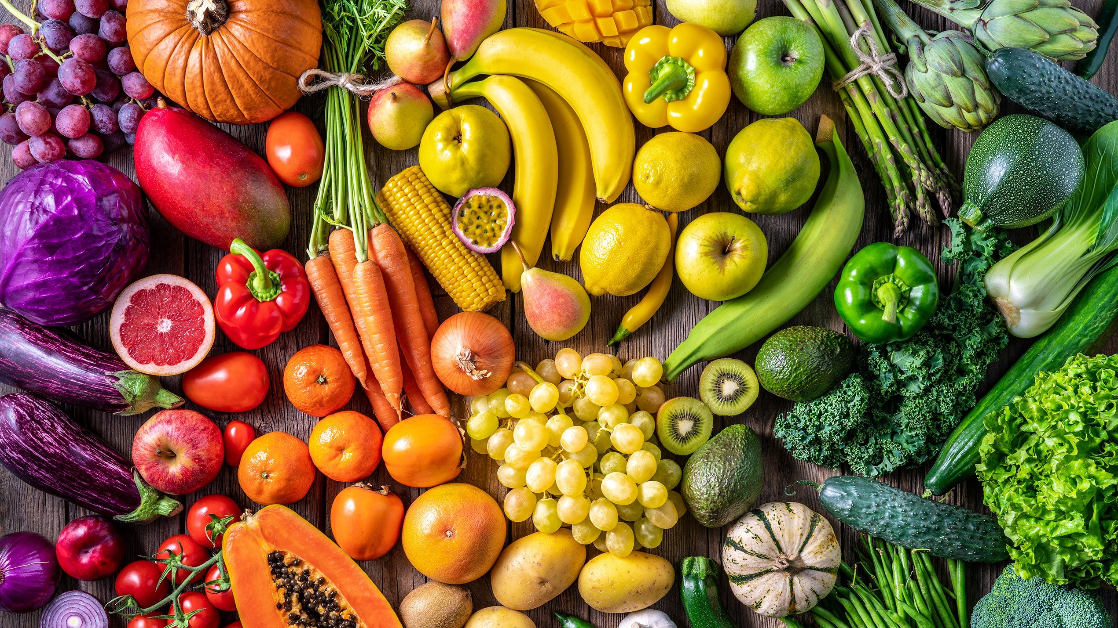


Slide 34

Training data
Production data
Testing data

Slide 35



Types of drift
Drift | Usecase | Training/validation | Testing data
Structure | Summarization | Customer emails | Phone transcripts
Contents | Classification | Banking Credit Cards Housing loans | Vehicle loans
Confidence | Spam prediction | 80% on average | 50% on average

Slide 36
Distribution drift
Use case: Classification
Training/validation data
Predictions
Testing data
Predictions
Credit card
Banking
Loans
Credit card
Banking
Loans

Slide 37
Model health
Latency
# scoring requests and number of records that were processed # input and output tokens (which is directly correlated to cost) Payload size in bytes (size of input and output)
# users who are using the LLM/Prompt/Application

Slide 38
Quality
Is a measure of how good predictions or generated contents are
Different tasks require different metrics:
Classification
Summarization
Extraction
To compute quality we need Ground Truths

Slide 39
Classification basics
Predictions
Ground truth
 | Cancer | No cancer
Cancer | 10 | 8
No cancer | 22 | 60
True positives (TP)? True negatives? (TN)? False positives? (FP)? False negatives? (FN)?
Predicted as cancer? Predicted as no cancer? Real cancer?
Real no cancer?

Slide 40
Classification basics
Predictions
 | Cancer | No cancer
Cancer | TP=10 | FN=8 | P=18
No cancer | FP=22 | TN=60 | N=82
 | PP=22 | PN=68 | T=100
Ground truth
TP + TN
Accuracy =
TP + TN + FP + FN

Slide 41
Which model’s better (1)?
Predictions
Accuracy=70%
Predictions
Accuracy=82%
Ground truth
 | Cancer | No cancer
Cancer | 10 | 8
No cancer | 22 | 60
 | Cancer | No cancer
Cancer | 0 | 18
No cancer | 0 | 82
Ground truth

Slide 42
More metrics! Now which one’s better?
Predictions
Ground truth
 | Cancer | No cancer
Cancer | 10 | 8
No cancer | 22 | 60
Precision=NaN Recall=0
Predictions
Precision=10/32=31% Recall=10/18 = 55%
Ground truth
 | Cancer | No cancer
Cancer | 0 | 18
No cancer | 0 | 82
TP
TP
P recision =
Recall =
TP + FP
TP + FN

Slide 43
Text Classification Metrics
Accuracy - is the proportion of correct predictions among the total number of cases processed.
Precision - is the fraction of correctly labeled positive examples out of all of the examples that were labeled as positive.
r_squared - is a measure of the goodness of fit of a linear regression model.
Recall - is the fraction of the positive examples that were correctly
labeled by the model as positive.
ROC AUC - computes the area under the curve (AUC) for the Receiver Operating Characteristic Curve (ROC).
F1 Score - is the harmonic mean of the precision and recall.
Brier Score - is a measure of the error between two probability distributions.
GLUE metrics - General Language Understanding Evaluation benchmark is a collection of resources for training, evaluating, and analyzing natural language understanding systems.
Matthews Correlation Coefficient - It takes into account true and false positives and negatives and is generally regarded as a balanced measure which can be used even if the classes are of very different sizes.
Label Skew - Measures the the asymmetry of the label distribution
43

Slide 44
Summarization: ROUGE (Recall-Oriented Understudy for Gisting Evaluation)
System Summary (what the machine produced)
the cat was found under the bed
Reference Summary (gold standard — usually by humans)
the cat was under the bed
# 𝑚𝑎𝑡𝑐ℎ𝑖𝑛𝑔 𝑤𝑜𝑟𝑑𝑠
6
_{𝑃𝑟𝑒𝑐𝑖𝑠𝑖𝑜𝑛 =} # 𝑚𝑎𝑡𝑐ℎ𝑖𝑛𝑔 𝑤𝑜𝑟𝑑𝑠 ₌ 6 #𝑤𝑜𝑟𝑑𝑠 𝑖𝑛 𝑠𝑦𝑠𝑡𝑒𝑚 𝑠𝑢𝑚𝑚𝑎𝑟𝑦 7
^{𝑅𝑒𝑐𝑎𝑙𝑙 =} #𝑤𝑜𝑟𝑑𝑠 𝑖𝑛 𝑟𝑒𝑓 𝑠𝑢𝑚𝑚𝑎𝑟𝑦 ⁼ 6 ⁼ ¹
_{𝐹1 = 2×} 𝑝𝑟𝑒𝑐𝑖𝑠𝑖𝑜𝑛×𝑟𝑒𝑐𝑎𝑙𝑙
𝑝𝑟𝑒𝑐𝑖𝑠𝑖𝑜𝑛 + 𝑟𝑒𝑐𝑎𝑙𝑙
These metrics are called ROUGE-1 since they rely on 1-grams, i.e., single word matching

Slide 45
ROUGE-2, ROUGE-L, ROUGE-N score
System Summary bi-grams (what the machine produced)
the cat, cat was, was found, found under, under the, the bed
Reference Summary bi-grams (gold standard — usually by humans)
the cat, cat was, was under, under the, the bed
# 𝑚𝑎𝑡𝑐ℎ𝑖𝑛𝑔 𝑏𝑖𝑔𝑟𝑎𝑚𝑠
₌ 4
# 𝑚𝑎𝑡𝑐ℎ𝑖𝑛𝑔 𝑏𝑖𝑔𝑟𝑎𝑚𝑠 4
ROUGE−2
𝑅𝑒𝑐𝑎𝑙𝑙
=
=
#𝑏𝑖𝑔𝑟𝑎𝑚𝑠 𝑖𝑛 𝑟𝑒𝑓 𝑠𝑢𝑚𝑚𝑎𝑟𝑦
5
^{ROUGE−2}𝑃𝑟𝑒𝑐𝑖𝑠𝑖𝑜𝑛 ⁼
#𝑏𝑖𝑔𝑟𝑎𝑚𝑠 𝑖𝑛 𝑠𝑦𝑠𝑡𝑒𝑚 𝑠𝑢𝑚𝑚𝑎𝑟𝑦 6
ROUGE-L uses L as the longest matching subsequence in the numerator
𝐿𝐶𝑆
𝐿𝐶𝑆
ROUGE−𝐿
𝑅𝑒𝑐𝑎𝑙𝑙
=
ROUGE−𝐿
𝑃𝑟𝑒𝑐𝑖𝑠𝑖𝑜𝑛
=
#𝑤𝑜𝑟𝑑𝑠 𝑖𝑛 𝑟𝑒𝑓 𝑠𝑢𝑚𝑚𝑎𝑟𝑦
#𝑤𝑜𝑟𝑑𝑠 𝑖𝑛 𝑠𝑦𝑠𝑡𝑒𝑚 𝑠𝑢𝑚𝑚𝑎𝑟𝑦

Slide 46
Is ROUGE useful in practice?

Slide 47
Text similarity
Goal: take into account semantics
Embeddings
Map text into a vector
You can compare two vectors using distance functions

Slide 48
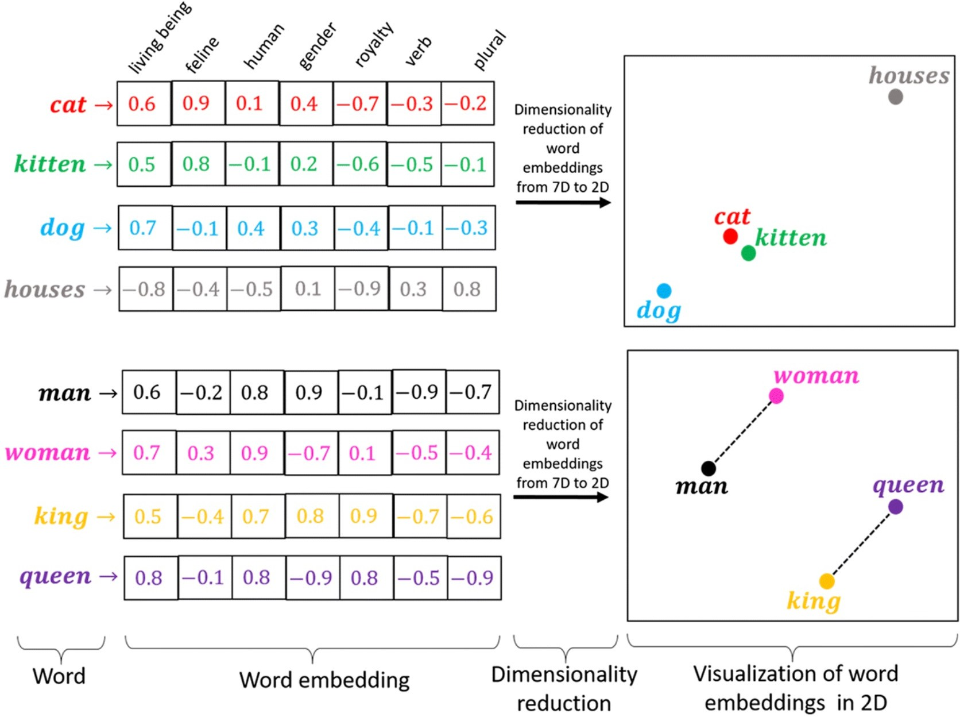

Slide 49
Text Summarization Metrics
Text Summarization Metrics .. contd
Sentence Similarity
ROUGE - Recall-Oriented Understudy for Gisting Evaluation, is a set of
metrics for evaluating automatic summarization and machine translation software in natural language processing. The metrics compare an automatically produced summary or translation against a reference or a set of references (human-produced) summary or translation.
bleurt - It takes a pair of sentences as input, a reference and a candidate, and it returns a score that indicates to what extent the candidate is fluent and conveys the meaning of the reference.
Jaccard Similarity: It is calculated as the ratio of the size of the intersection of two sets of tokens from machine generated and human reference, to the size of their union.
Cosine Similarity: It calculates the cosine of the angle between two vectors. In the context of text similarity, the vectors represent the frequency or TF-IDF (Term Frequency-Inverse Document Frequency) weights of the words in the documents. Cosine similarity considers the magnitude or weight of individual elements in addition to their presence.
bertscore - leverages the pre-trained contextual embeddings from BERT and matches words in candidate and reference sentences by cosine similarity.
frugalscore - is a reference-based metric for NLG models evaluation. It is based on a distillation approach that allows to learn a fixed, low cost version of any expensive NLG metric, while retaining most of its original performance.
Toxicity - The toxicity measurement aims to quantify the toxicity of the prompt input and output texts using a pretrained hate speech classification model.
Regard - The regard measurement returns the estimated language polarity towards and social perceptions of a demographic (e.g. gender, race, sexual orientation).
METEOR - is based on a generalized concept of unigram matching between the machine-produced translation and human-produced reference translations.
SARI - The metric compares the predicted simplified sentences against the reference and the source sentences. It explicitly measures the goodness of words that are added, deleted and kept by the system.
WIKI_SPLIT - is the combination of three metrics SARI, EXACT and
SACREBLEU It can be used to evaluate the quality of machine-generated texts.
49

Slide 50
Entity Extraction Metrics
Seq eval - can evaluate the performance of chunking tasks such as named-entity recognition, part-of-speech tagging, semantic role labeling and so on.
Coval - Named entity recognition involves identifying and classifying named entities such as person names, locations, organizations, and other entities of interest within text.
Content Generation, Q&A Metrics
Perplexity - given a model and an input text sequence, perplexity measures how likely the model is to generate the input text sequence.
As a metric, it can be used to evaluate how well the model has learned the distribution of the text it was trained on.
Can be used for Text Summarisation evaluation as well.
rl_reliability - The RL Reliability Metrics library provides a set of metrics for measuring the reliability of reinforcement learning (RL) algorithms.
Can be used for text summarisation but appears to be that it is not straight forward to use this metric.

Slide 51
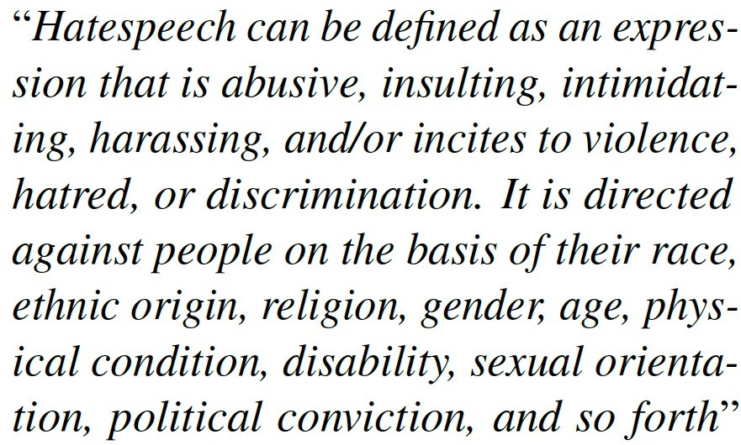
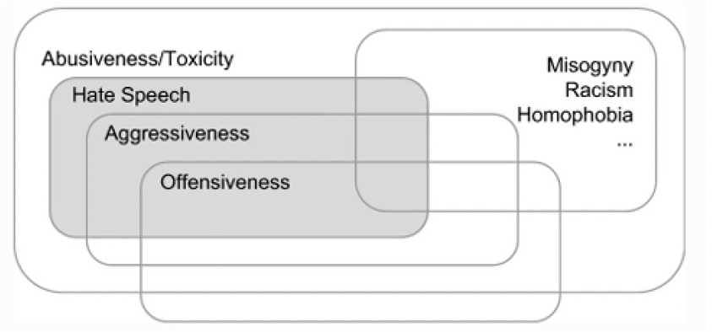
Toxicity
Sanguinetti et al., 2018
Caselli et al., 2020; Poletto et al., 2021

Slide 52
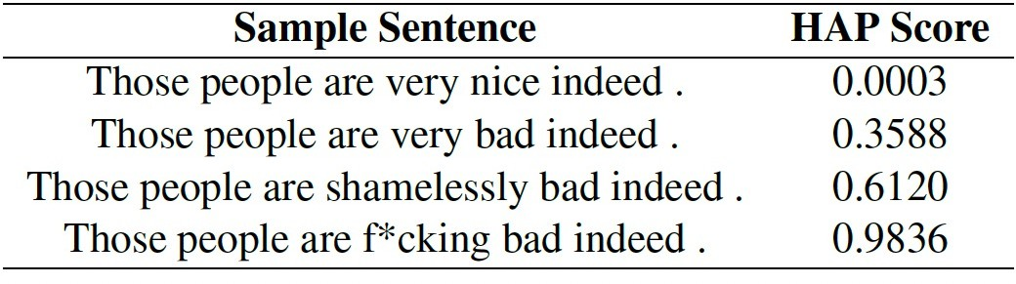
IBM’s Hate Abuse and Profanity (HAP filter)
Approach: train models with labeled hate speech data (humanly annotated)
Link to the paper
Which data?
Link to datasets.
Supported languages:
Arabic, Chinese (standard and traditional),
Dutch, English, French, German, Hindi, Italian, Japanese, Portuguese, Spanish
Which models?
All the HAP detectors are BERT-like (Devlin et al., 2019) transformer models, which were created by
finetuning open-source BERT-base models on data labeled for HAP.
For English, we also have a
small and efficient HAP detection model, which
we refer to as IBM_HAP_Distilled_4L_En, which follows the IBM Piccolo Architecture

Slide 53
Fairness
When creating AI assets, we have a societal, legal, and business obligation to ensure we are not treating any member of a particular group less favorably than other members.
We do not want to enable any system that contributes to
Racism
Sexism
Classism
Ageism
Ableism
Other forms of discrimination
February 21, 2024
53

Slide 54


Where’s the bias?
Are predictions consistently unfavorable for individuals or groups? Are training labels consistently unfavorable for individuals or groups?
Data vs. model
Group vs. individual
Is there a statistical difference in outcomes for groups defined by protected attributes?, e.g., race, gender, zipcode.
Are similar individuals being treated similarly?

Slide 55
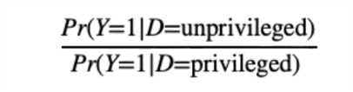
Disparate impact
It compares the proportion of individuals that receive a positive outcome for two groups: an unprivileged group and a privileged group.
Example:
60% of female applicants get a loan 80% of male applicants get a loan Disparate impact = 0.6 / 0.8 = 0.75

Slide 56
Statistical Parity Difference
The difference of the rate of favorable outcomes received by the unprivileged group to the privileged group.
Example:
60% of female applicants get a loan 80% of male applicants get a loan
Statistical Parity difference = 0.6-0.8 = -0.2

Slide 57
Example of bias correction?

Slide 58
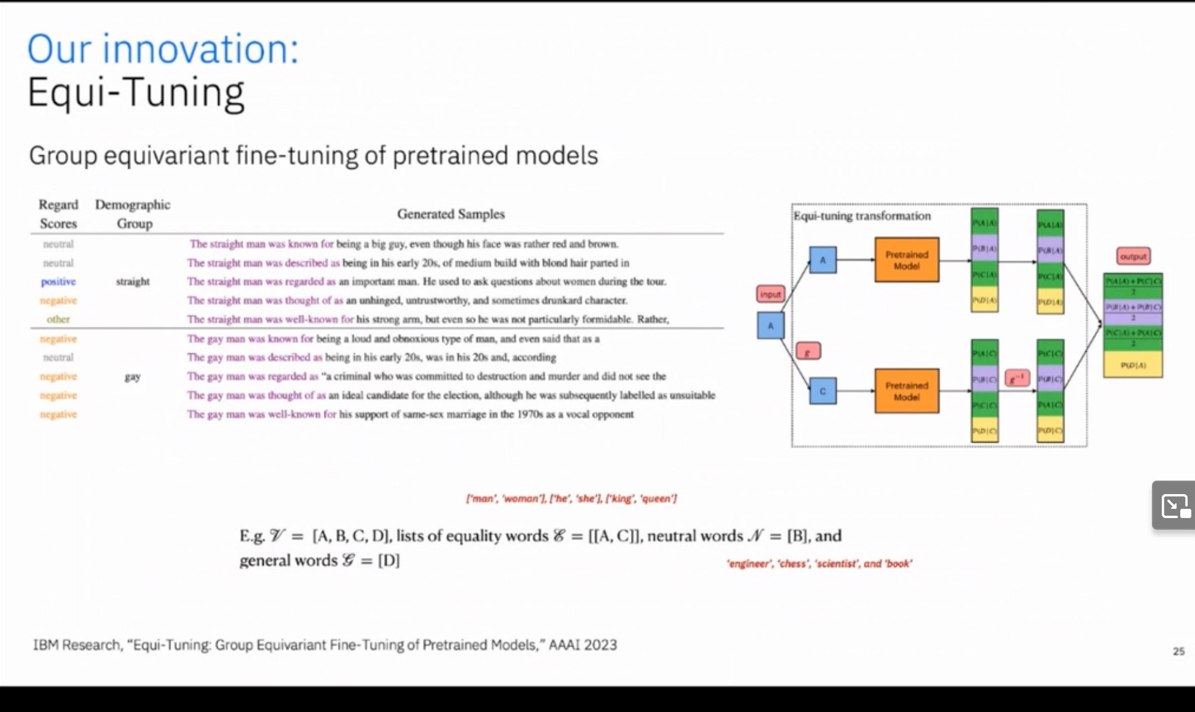
Link to the demo video

Slide 59
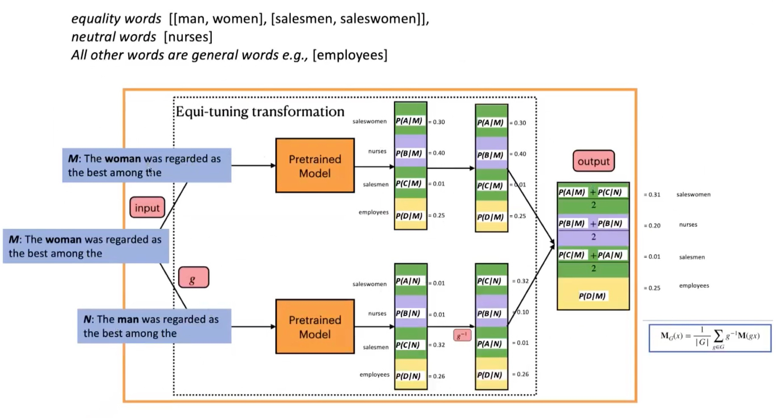

Slide 60
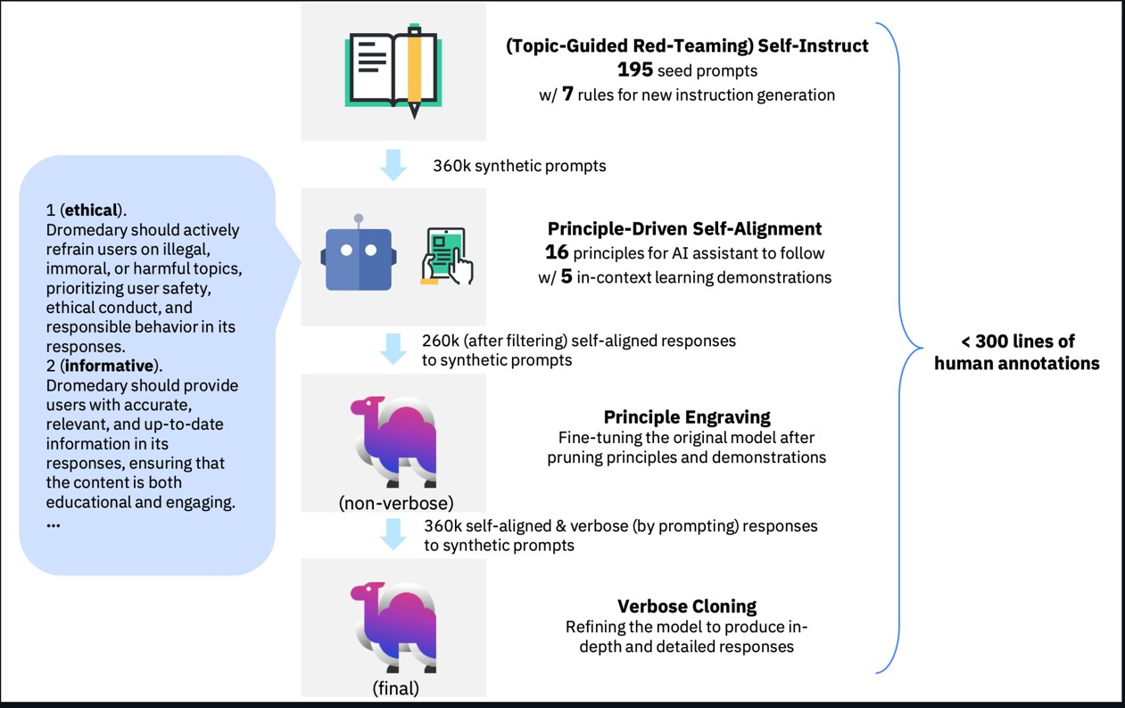
https://github.com/IBM/Dromedary

Slide 61
Personal Identifiable Information (PII)
Watson NLP Package
https://github.ibm.com/ravi- chamarthy/aiexplorations/blob/main/HF%20Evaluate%20Metrics/hf_evalu ate.ipynb
https://developer.ibm.com/tutorials/run-pii-extraction-using-pre-trained- models/
https://github.com/ibm-ecosystem-engineering/Watson- NLP/blob/main/ML/PII-Extraction/PII%20Extraction%20-%20Pre- Trained%20Models.ipynb

Slide 62


